Slide 1
MECH-APEX ZERO DEMO
Prepared by: Chicken and Sausages
Tian Guo
Saim Zahid
Jonathan Yu
Yicheng Chen
Yanting Zhang

Slide 2
WHAT IS MECH-APEX ZERO
Mecha-Apex Zero is the new generation of the Metroidvania formula
Sci-Fi setting
Masterfully crafted platforming levels
Fast-paced combat
Tons of enemies
Multiple playable characters
Notes:
How is our game different/better than competitors?
Mech-APEX Zero is different than our competitors because it offers a brand new combo feature that provides the players with 6 different directional moves and 4 specials moves allowing players to create and execute many different sequences of combos. It also has stunning 2D graphics that will clearly express the actions and intent of enemies allowing players to dodge, giving them the illusion of outsmarting the enemy. It has sounds and music that fit the nature of the game enhancing the atmosphere of the game world. It takes the fun elements from classic games and combines them for an enhanced experience. Metroid and castlevania both have strong platformer elements but doesn’t have the same depth in player vs enemy combat. Contrary Smash has a good combo system but focuses mainly on player vs player fighting.
Quick description of game and its benefits
Mech-APEX Zero is a 2D puzzle/action game set within a highly futuristic Earth where they are at war with the Space Colonies. The player plays as Kyle Braiden, who pilots a humanized robot called mobile suits and fights for the Earth Forces against the rebel Space Colonies. It fulfills the player’s need to escape and experience a different world with futuristic technology, to be put into a world where he is a ace pilot .

Slide 3
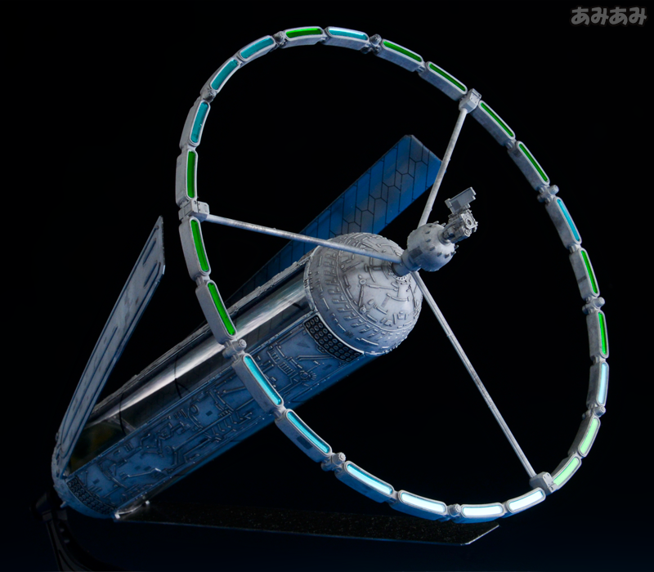
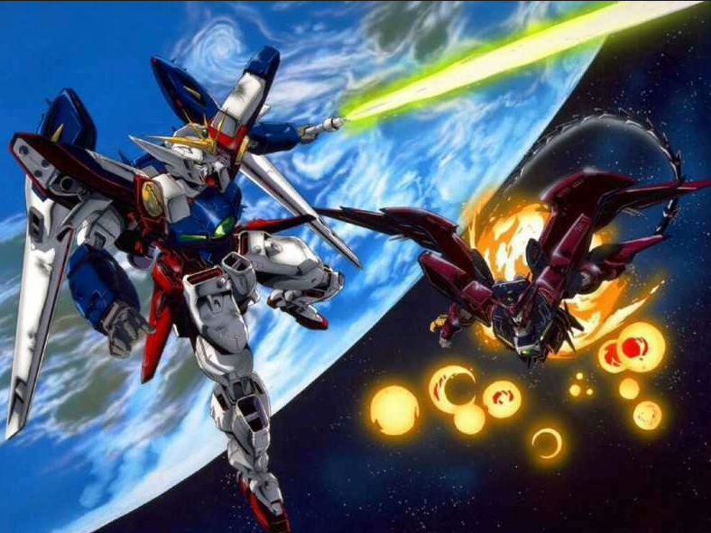
LORE
Takes place in the not too distant future (within few hundred years)
Mega structures called Space Colonies became humanity’s first home outside of Earth
Political and Economic tension lead to war between Colony Independants and Central Earth government
This war is fought by Giant Mech Suits

Slide 4
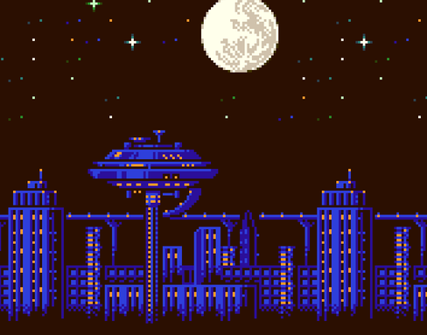
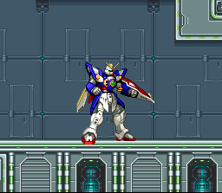
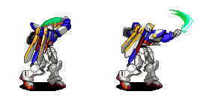
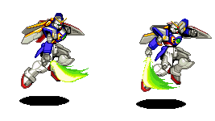
GAMEPLAY
Beautiful 2D world
Intuitive combat
Stylish Combos
Deceptive skill ceiling

Slide 5
Special Features
Final Goal
Aiming At
Combo
Achievements
Hidden Items
Character progression & upgrades
Multiple playable main character
Item Collection
Weapon loadouts
Mecha Hanger/R&D Lab
MORE playable main character

Slide 6
INSPIRATION
Metroid
Castlevania
Super Smash Bros
Notes:
The biggest inspiration for this project is the Metroid and Castlevania franchises. The cohesive aesthetics and level design are areas that this project will attempt to achieve the same level of competence as the classics of this Genre. The fighting mechanics of Super Smash Bros Franchise will be used to inspire the combat mechanics of this game to introduce new elements of the old platformer formula.

Slide 7
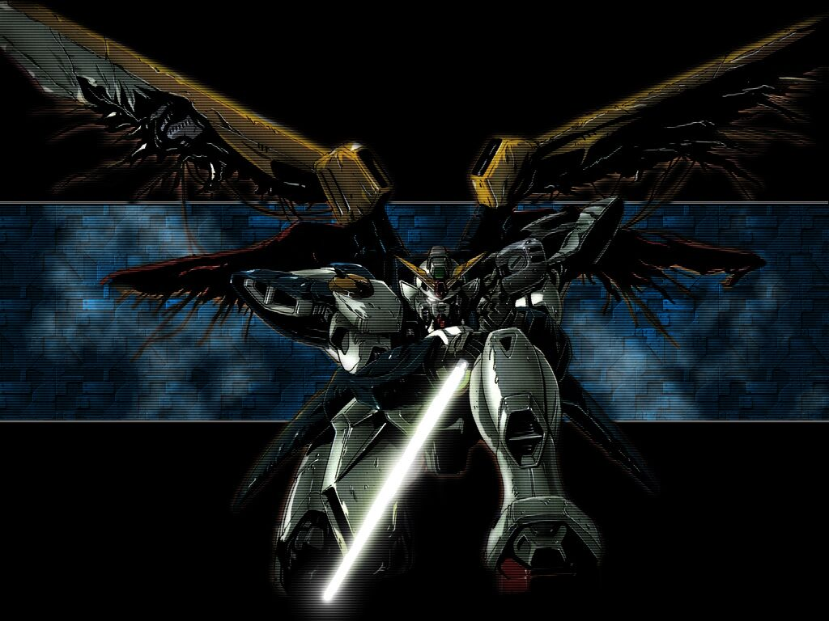
Thank You!
Notes:
^-^! yeah

Slide 8
References
Assets used:
Character Asset: Gundam Wing: Endless Duel, by Bandai
Background Asset: Megaman, by Capcom
Screenshots: Gundam Wing, by Sunrise

